Slide 1
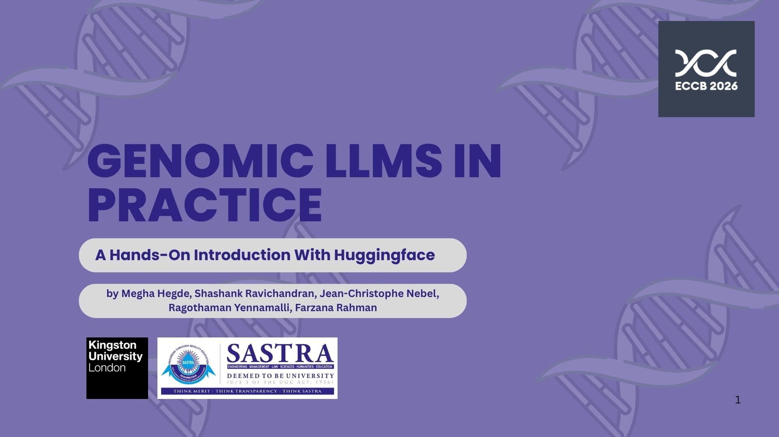

Slide 2


Introduction to Genomic Large Language Models (LLMs)
Tutorial VT1: Genomic LLMs in Practice
– A Hands-On Introduction with Hugging Face
Presented by Prof. Jean-Christophe (JC) Nebel

Slide 3
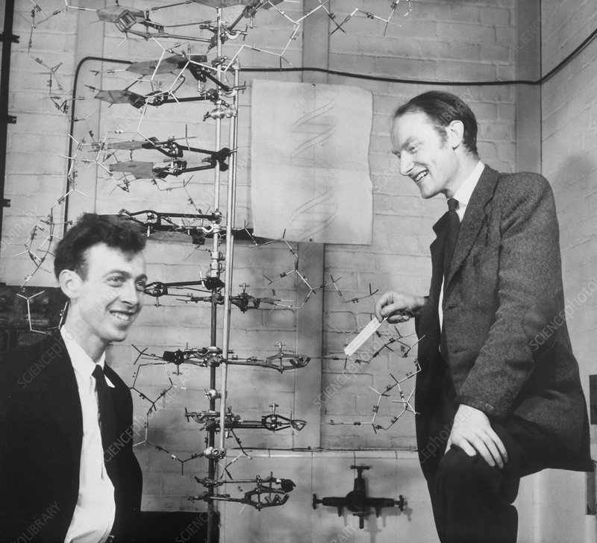
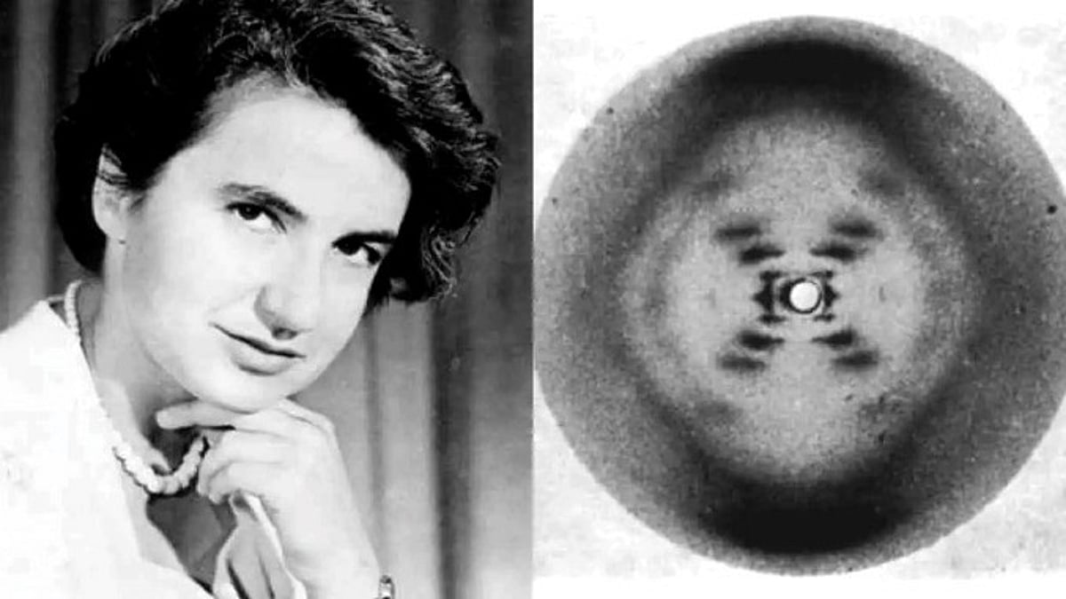
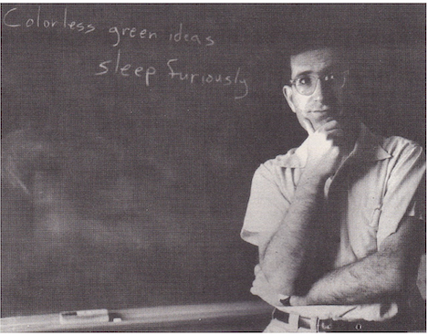
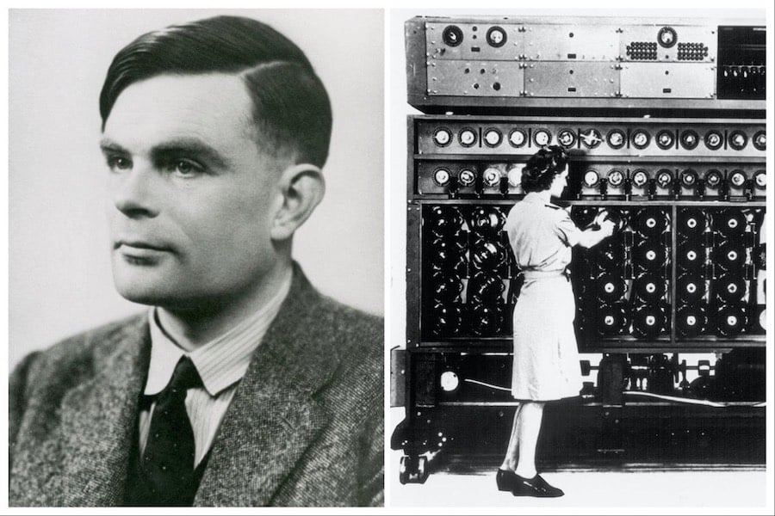
Genomic LLMs: Back to the ‘50s revolutions
Discovery of the structure of DNA - Watson, Crick and Franklin (1953) [1]
Led to formulation of a linguistic metaphor in molecular biology: ‘the sequence of the bases is the code which carries the genetic information’
Language as generative system – Linguist/philosopher Chomsky (1957) [2]
Language is reconceived as a formal system generating infinite structures from finite rules
Complex natural phenomena can be interpreted as systems of discrete symbols governed by combinatorial rules
Can machines think? Reframed into the imitation game – Turing (1950) [3]
Establishment of Artificial Intelligence as a scientific field – Dartmouth Summer Research Project on Artificial Intelligence in 1956 [4]

Slide 4
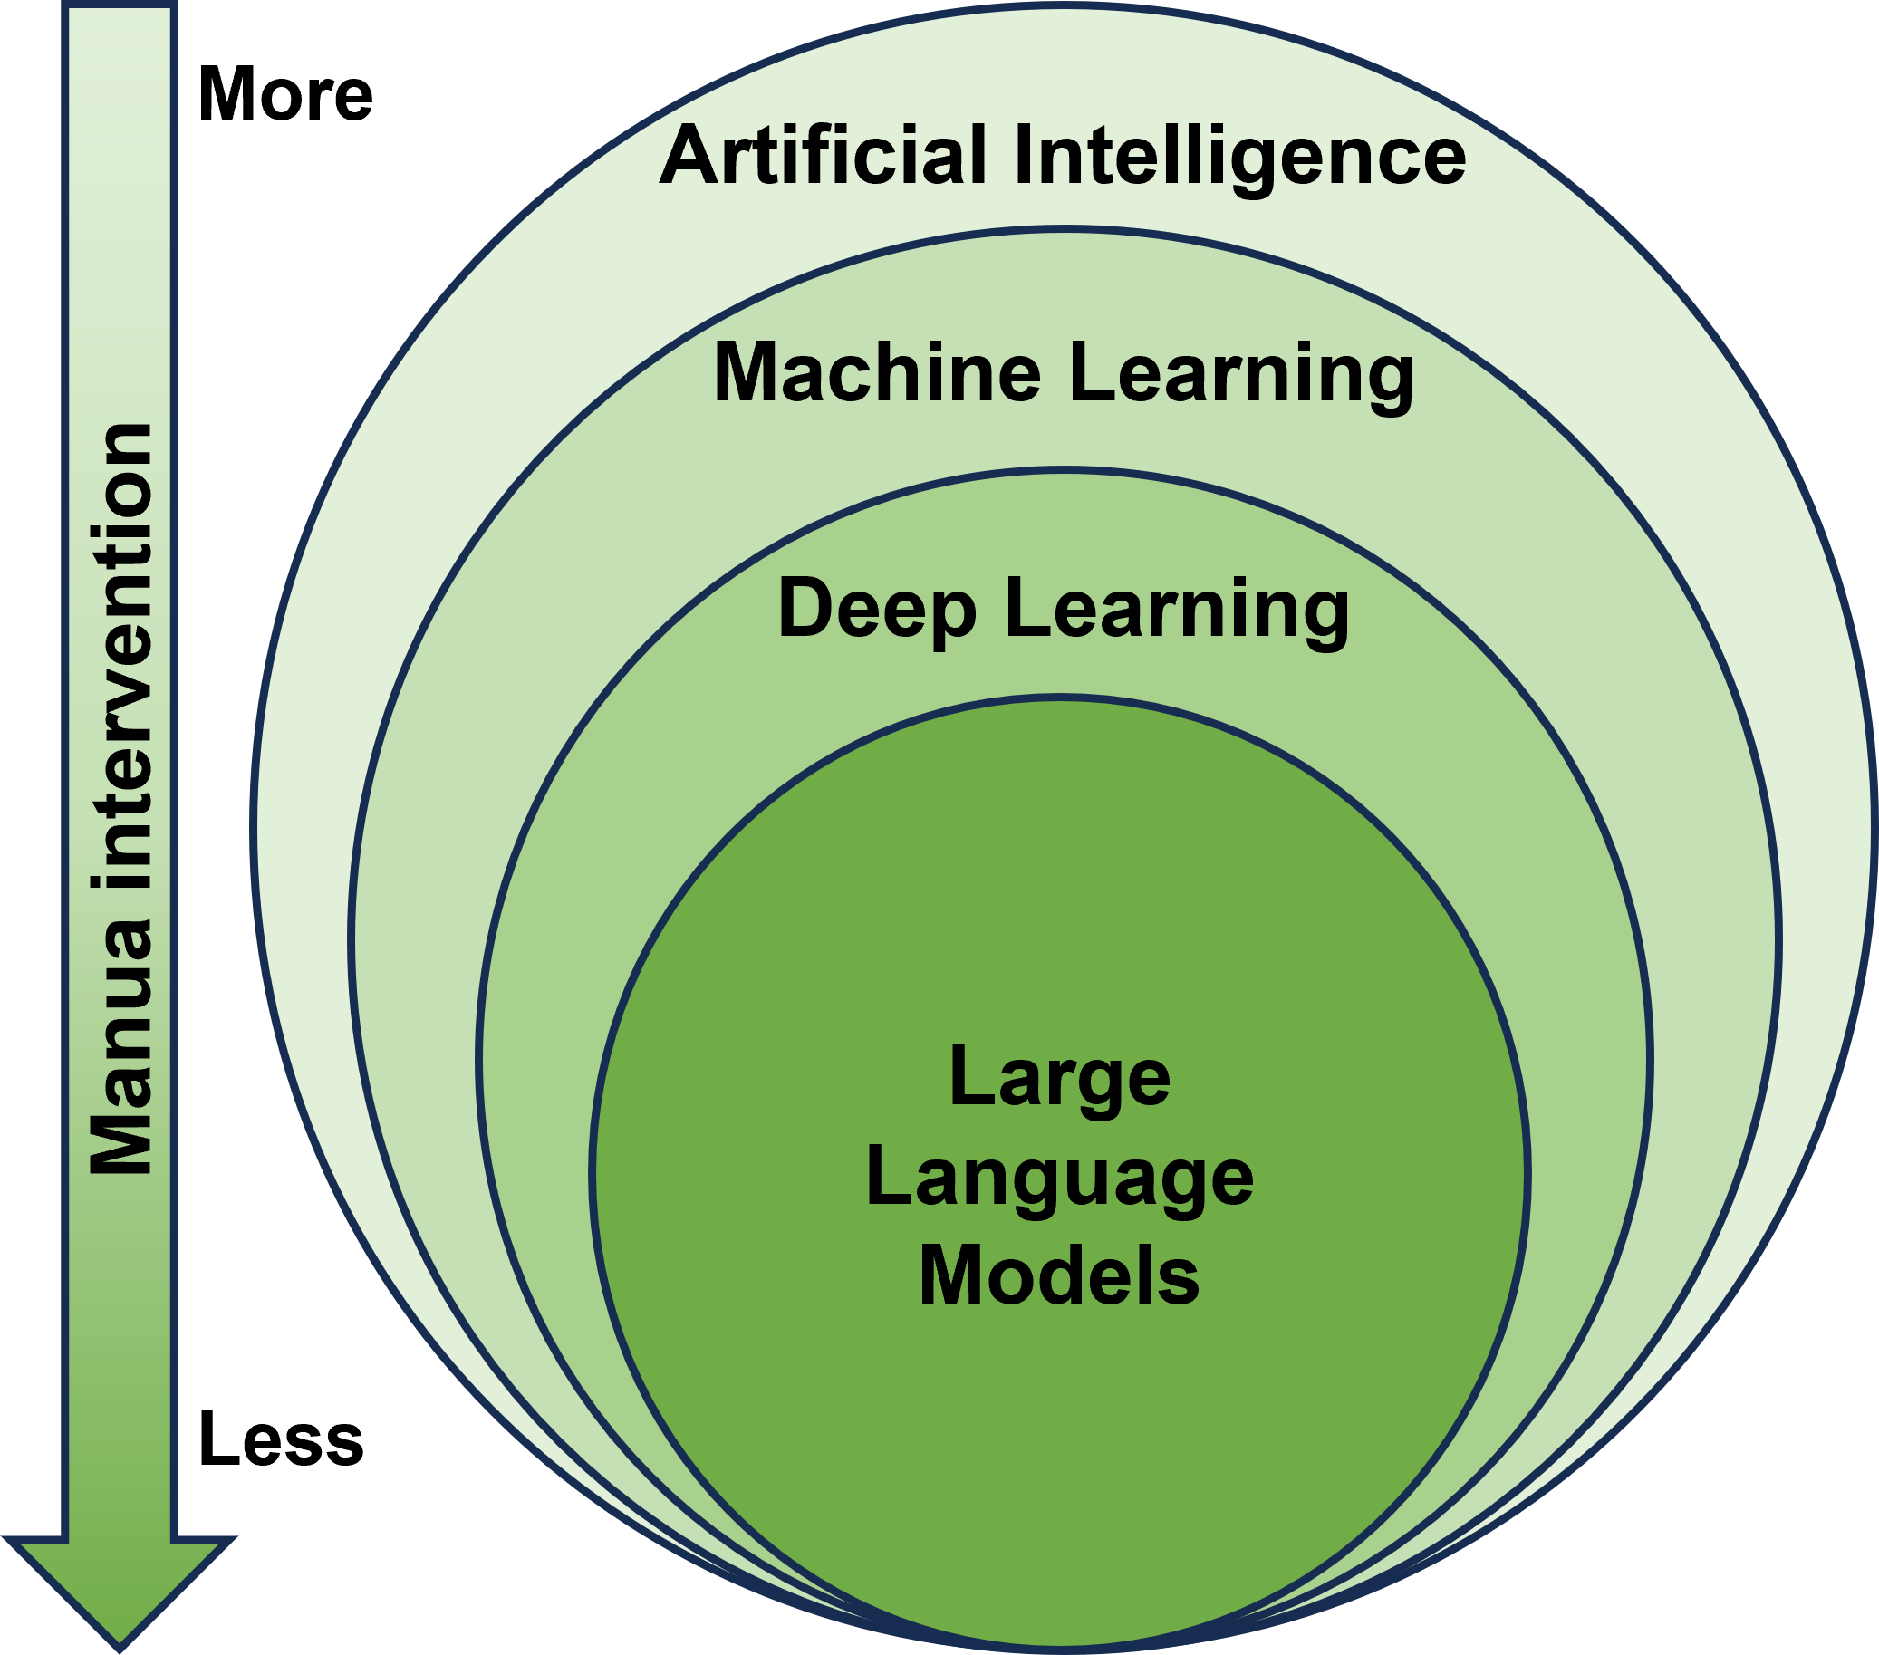
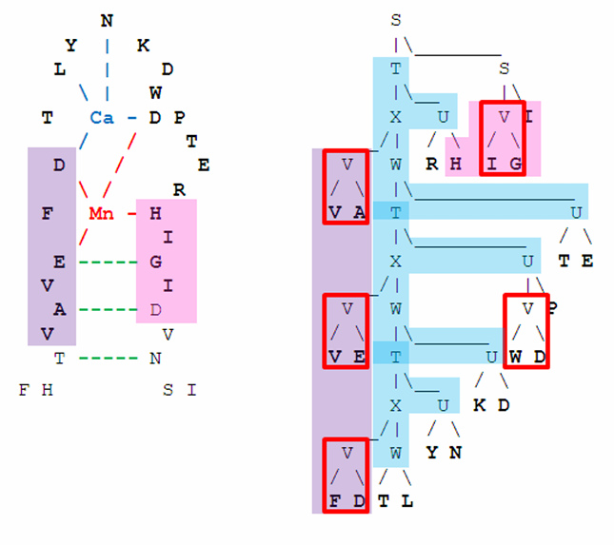
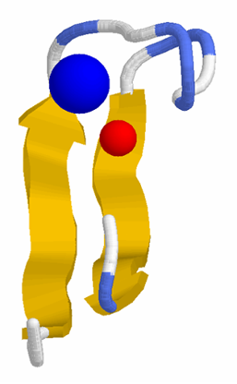
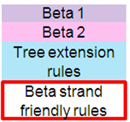
AI-Driven Natural Language Processing for Genomics
Symbolic AI
Rule-based systems – e.g., grammar-based binding site descriptors [5]
F1 score: 0.91
Notes:
The F1 score is the harmonic mean of precision and recall:
$$F1=2×\frac{\text{Precision}×\text{Recall}}{\text{Precision}+\text{Recall}}$$
Where:
Precision = How many predicted positives are actually correct
Recall = How many actual positives were correctly found

Slide 5
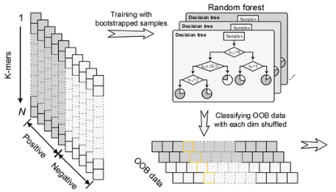
AI-Driven Natural Language Processing for Genomics
Traditional Machine Learning Methods
Typically perform well on small to medium datasets
Depend on manual feature engineering
Linear Regression, Random Forest, Naive Bayes, SVM…
E.g., Prediction of the potential risk of a genetic variant using Random Forest and k-mer features [6]

Slide 6
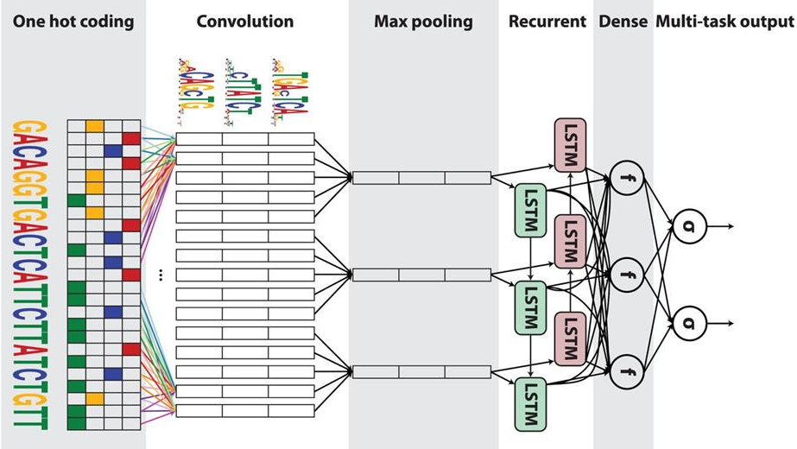
AI-Driven Natural Language Processing for Genomics
Deep Learning Methods
Convolutional Neural Networks (CNNs) learn local patterns (motifs) in sequences using convolutional filters
Recurrent Neural Networks (RNNs) capture sequential dependencies
Autoencoders (AE) learn low-dimensional representations of data
CNN, RNN, hybrid model…
E.g., Prediction of non-coding sequence function (DanQ) [7]
Notes:
A bi-directional long short-term memory network (BLSTM) is a variant of the RNN that combines the outputs of two RNNs, one processing the sequence from left to right, the other one from right to left. Instead of regular hidden units, the two RNNs contain LSTM blocks, which are smart network units that can remember a value for an arbitrary length of time.

Slide 7
AI-Driven Natural Language Processing for Genomics
The Transformer made LLMs possible by enabling models to scale efficiently and learn rich language representations.
The Transformer
Notes:
A bi-directional long short-term memory network (BLSTM) is a variant of the RNN that combines the outputs of two RNNs, one processing the sequence from left to right, the other one from right to left. Instead of regular hidden units, the two RNNs contain LSTM blocks, which are smart network units that can remember a value for an arbitrary length of time.

Slide 8
A Pivotal Shift: The Transformer
Text translation used to rely on RNN models that compress an entire sentence into a single fixed vector and process it sequentially.
Attention mechanism (2014) [9]: Foundation of the Transformer
Problem: With long sentences, important information in the vector can be lost or diluted.
Solution: The model dynamically “pays attention to” to the most relevant parts of the input sequence when generating each word.
“Attention is all you need” (2017) [10]: The Transformer
Remaining issue: Sequential processing limits efficiency and scalability.
Key idea: The model attends to all words simultaneously, enabling parallel processing and more effective learning of relationships.
Notes:
A bi-directional long short-term memory network (BLSTM) is a variant of the RNN that combines the outputs of two RNNs, one processing the sequence from left to right, the other one from right to left. Instead of regular hidden units, the two RNNs contain LSTM blocks, which are smart network units that can remember a value for an arbitrary length of time.

Slide 9
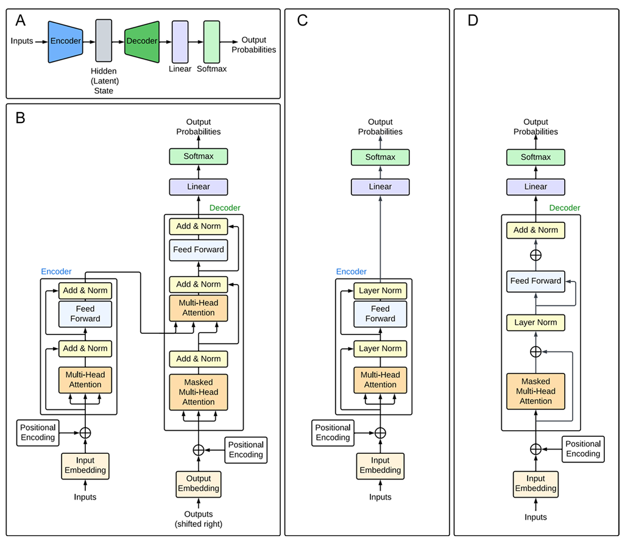
Transformer
Architecture
Encoder-Decoder Transformer
The encoder maps the input to a latent representation
The decoder generates the output
Linear & softmax layers for prediction
Detailed Architecture [10]
Multi-head attention runs parallel self-attention layers, combined with fully connected layers.
Encoder-only Transformer [11]
Sequence analysis
Decoder-only Transformer [12]
Sequence generation
.

Slide 10
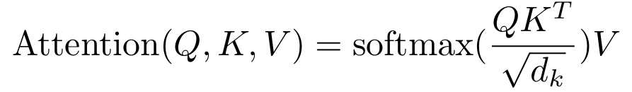
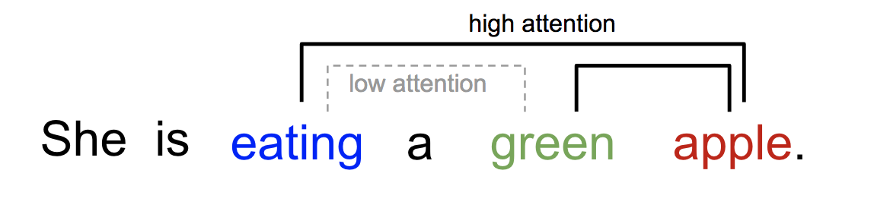
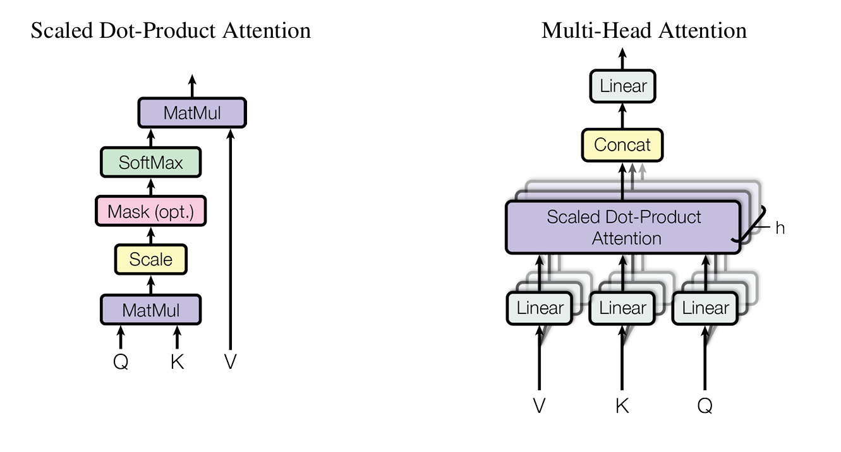
Attention Mechanism
[10]
Scaled dot-product attention
Most basic form of self-attention, which allows a model to weigh up the importance of different parts of an input sequence
Input consists of queries (Q) and keys (K) of dimension d_{k}, and values (V) of dimension d_{v}
Multi-head attention
Runs multiple self-attention processes in parallel
Allows the model to jointly attend to information from different representation subspaces at different positions
[23]
Attention value 1
ACTGACTGACTGACTGACTGACTG
[10]
Attention value 2
Attention value 3

Slide 11
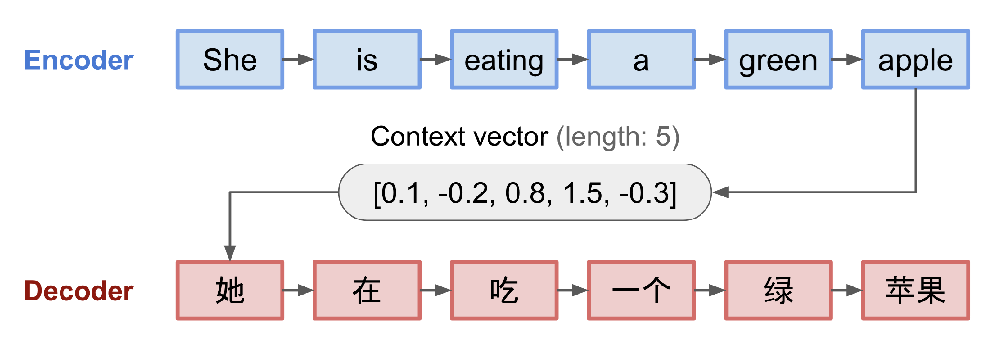
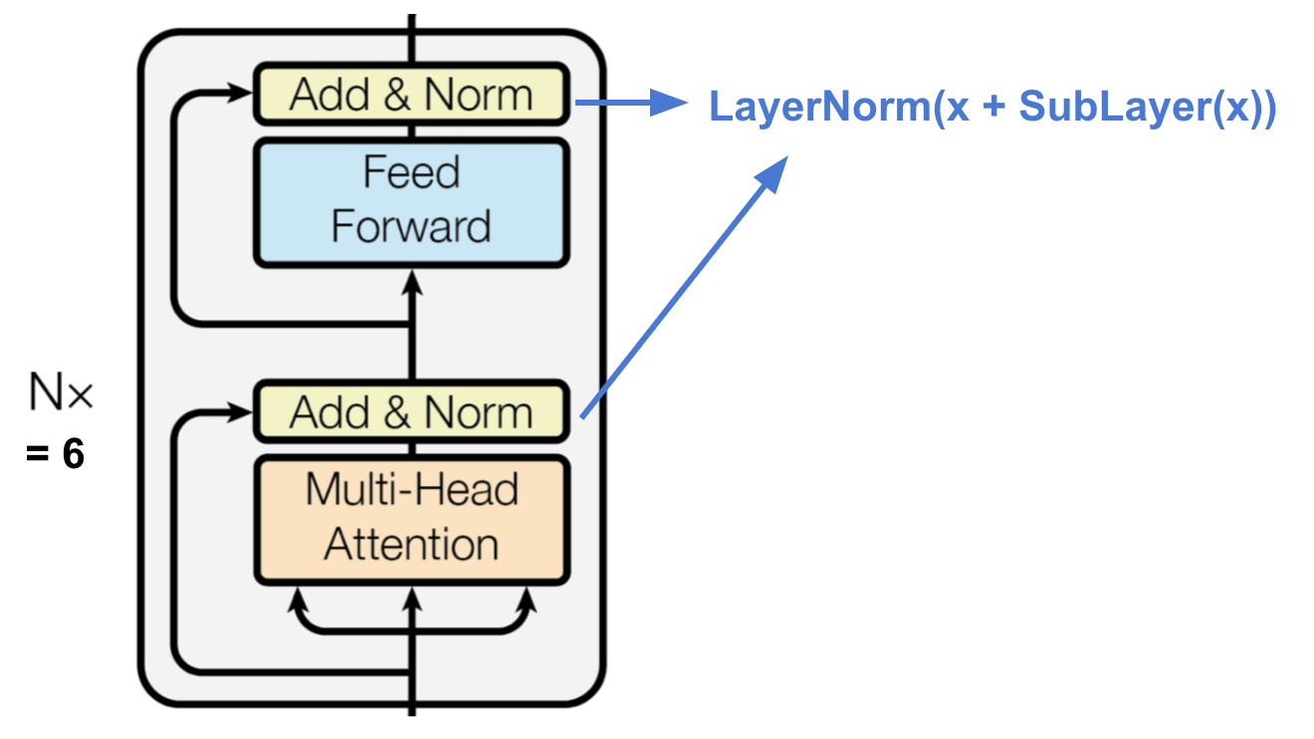
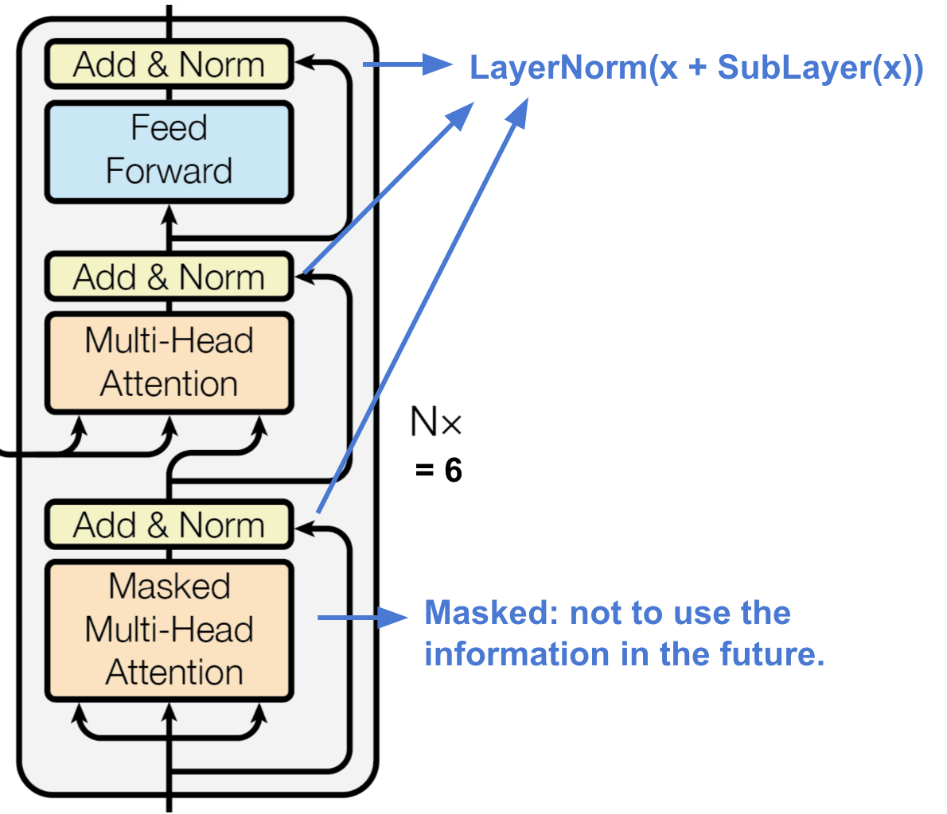
Encoder vs Decoder
[23]
Encoder
Stack of identical layers: each containing a multi-head self-attention mechanism and a fully connected feed-forward network
Generates an attention-based representation of the data
Can find specific information from long context
Decoder
Stack of identical layers: in addition to the sub-layers in the encoder, each of the decoder layers contains a third sub-layer which performs multi-head attention over the output of the encoder stack
Retrieves information from the encoded representation

Slide 12
Tokenisers – Introduction
Deep learning reduces manual feature design, but it does not eliminate assumptions. In genomic LLMs, those assumptions are embedded in choices like tokenisation and model architecture.
Tokenisation: the process of converting raw DNA sequences (ATGCGTACGTTAGC…) into discrete “tokens” that a model can understand and process, e.g.,
Single-nucleotide tokens (A | T | G | C …): Simple, no assumption… but sequences can be very long, and it is harder to learn higher-order patterns
Codon-based tokens (ATG | CGT …): Biologically meaningful in coding regions only
K-mers (fixed-length chunks, e.g., ATGC | GTAC …): Split sequence into non-overlapping or overlapping substrings
Data-driven tokenisation (ATG | CGTA | CGT ...): e.g., BPE, WordPiece, & SentencePiece

Slide 13
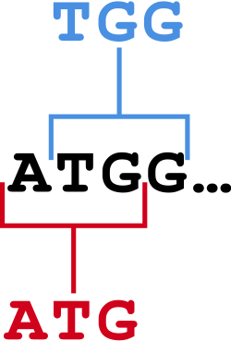
Tokenisers – K-mers
The sequence is split into substrings of a fixed length k (called k-mers)
Non-overlapping k-mers (used by Nucleotide Transformer, k=6):
Pros:
Reduce sequence length
Simpler computational processing
Cons:
May miss motifs spanning token boundaries
Less robust to sequence variations (indels create dramatic changes)
Overlapping k-mers (used by DNABERT-1, k = 3 to 6):
Pros:
Captures local motifs effectively
Provides richer context via overlap
Cons:
Introduce redundancy and longer sequences
Higher computational and memory load

Slide 14
Tokenisers – Byte-Pair Encoding (BPE) (used by DNABERT-2 [20], GROVER [21])
With fixed-length tokens, token frequencies become very heterogeneous
Genomes are not random strings, e.g., many genomes are A/T-rich because CG dinucleotides are prone to mutation
BPE assumes that frequently occurring substrings are meaningful.
It builds progressively larger tokens from frequent sequence content by iteratively merging the most common adjacent token pairs.
Let’s encode AAAGTAAAGAC using BPE:
Sequence Tokens
AAAGTAAAGAC {A, G, T, C}
XAGTXAGAC {A, G, T, C, X}, where X = AA
XYTXYAC {A, G, T, C, X, Y}, where Y = AG & X = AA
ZTZAC {A, G, T, C, X, Y, Z}, where Z = XY, Y = AG and X = AA
i.e., [AAAG][T][AAAG][A][C]

Slide 15
Large Language Models (from 2018)
Large-scale models built on the Transformer architecture
Have usually billions of parameters
Trained in an unsupervised manner (no need for labels) on large corpora of sequence data requiring significant amount of processing power
Ability to accurately model long-range dependencies within sequences
Data
Pretraining
Fine-tuning
LLM Architecture
Base Model (Foundation Model)
Tokenisation
Task-specific Data
Base Model
Fine-tuned Model
Tokenisation
Notes:
A bi-directional long short-term memory network (BLSTM) is a variant of the RNN that combines the outputs of two RNNs, one processing the sequence from left to right, the other one from right to left. Instead of regular hidden units, the two RNNs contain LSTM blocks, which are smart network units that can remember a value for an arbitrary length of time.

Slide 16

GPT-1 - Generative Pre-trained Transformer (2018) [12]
‘General language generator’ by OpenAI
Architecture
Decoder-only transformer
Layers: 12 - Token (hidden) size: 768 - Self-Attention heads: 12 - Parameters: 117M
Pretraining
The BooksCorpus (800M words)
GPT family
Model | Year | Parameters
GPT-1 | 2018 | 117M
GPT-2 (largest | 2019 | 1.5B
GPT-3 (largest) | 2020 | 175B
GPT-3.5 – used in first ChatGPT release (Nov. 2022) | 2022 | ~175B
GPT-4 | 2023 | 100B–1T
GPT‑5‑class (ChatGPT today) | 2025–2026 | >1T
Notes:
BERT & GPT (2018) — the two foundational Transformer directions that defined modern NLP.

Slide 17
BERT - Bidirectional Encoder Representations from Transformers
‘Universal language understanding model’ (2018) [13] by Google AI
Architecture
Encoder-only transformer
Bidirectional: learn information from a text from the left and right side
BERTBASE: Layers: 12 - Token (hidden) size: 768 - Self-Attention heads: 12 - Parameters: 110M
BERTLARGE: Layers: 24 - Token (hidden) size: 1024 - Self-Attention heads: 16 - Parameters: 340M
Pretraining
The BooksCorpus (800M words) & English Wikipedia (2,500M words)
4 days: BERTBASE on 16 TPUs BERTLARGE: on 64 TPUs (<$1M capital cost)
Fine-tuned on 11 different NLP tasks
Many BERT variants including RoBERTa, ALBERT, DistilBERT, ELECTRA
DNABERT-2 (2024) [14] based on BERTBASE (~117M parameters) – TinyDNABERT to be used in workshop
but BPE tokenisation and trained on multi-species genomes (810+)
Most LLMs for genomics rely on a BERT-like architecture, including Nucleotide Transformer (2025)

Slide 18
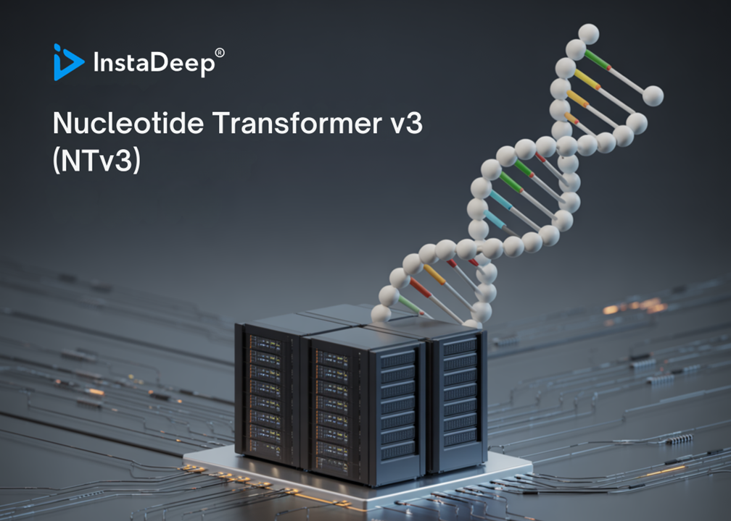
Nucleotide Transformer
Large-scale, high-capacity genomics foundation model (2025) [15]
by InstaDeep + NVIDIA + academia
Architecture
Encoder-only transformer & bidirectional (similar to BERT)
From 6 to 36 layers, from 50M to 2.5B parameters
Tokenization: 6-mer non-overlapping tokens
Pretraining
Multi-species genomes (850+)
Training time: not reported, but used
Cambridge‑1 Supercomputer (~$100M, ~8 PFLOPS)
to be used in guided hands-on session

Slide 19
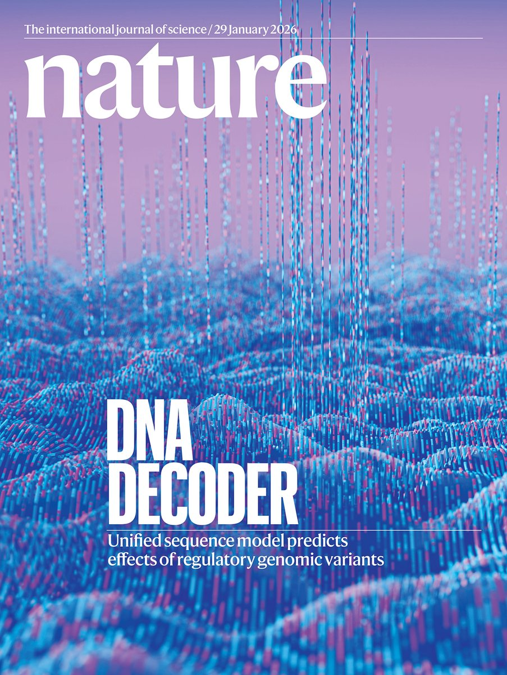
AlphaGenome – A biological system model
To go beyond syntax of DNA by learning semantics and function of DNA (2026) [16]
by Google DeepMind
Architecture
Hybrid architecture: a U‑Net-inspired backbone architecture with convolutional layers + transformer blocks + decoder
Use single-nucleotide tokens
Not a pure language model, integrating:
DNA sequences (up to 1Mb long)
Real biological measurements
Probably >1B parameters
Pretraining
Large-scale experimental genomics datasets (ENCODE, GTEx… ),
learning to map DNA sequences to thousands of biological
signals such as gene expression, chromatin accessibility,
and 3D genome structure

Slide 20
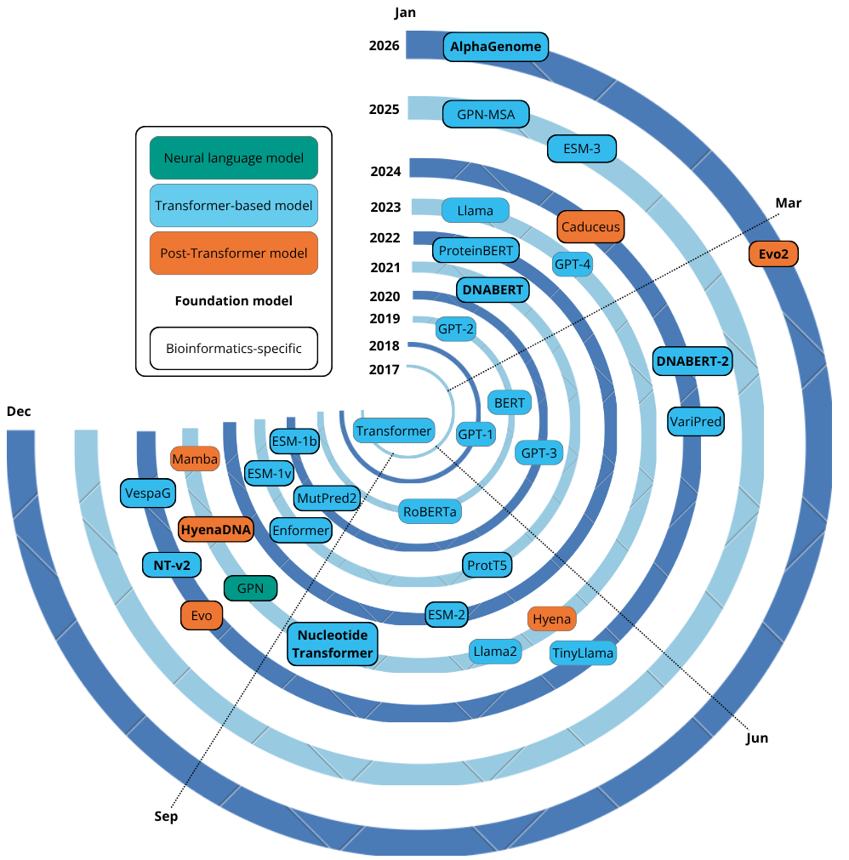
Beyond Transformer-Based Architectures
Long sequences are limited by quadratic scaling of Self-Attention
Hyena operator: a long convolution-style near-linear (smart) operator
HyenaDNA (100-300M param., 2023 [17]) & Evo (7B parameters, 2024 [18])
Mamba operator: linear-time state-space model with selectivity, that decides what to remember/forget dynamically (seq. nature)
Caduceus (100-300M parameters, 2024)
- genome-scale sequence
AlphaGenome (2026) [16]: next-generation genomic foundation model
Timeline of developments in NPL since 2017

Slide 21
Conclusion
Genomics as a language: DNA sequences can be modelled using NLP and LLM paradigms
Transformer-based models (DNABERT, Nucleotide Transformer) enabled large-scale genomic learning
Their key limitation: quadratic scaling restricts long-context modelling
Hyena and Mamba operators towards genome-scale sequences
AlphaGenome: integrates sequence, function, and biological signals
Paradigm shift: from sequence modelling to functional genomic understanding
Notes:
“Genomic LLMs are evolving from sequence predictors to comprehensive models of biological systems.”

Slide 22
References – 1/2
[1] Watson, J., Crick, F. (1953) Molecular Structure of Nucleic Acids: A Structure for Deoxyribose Nucleic Acid. Nature 171, 737–738
[2] Chomsky, N. (1957) Syntactic structures. The Hague: Mouton
[3] Turing, A. M. (1950) Computing Machinery and Intelligence. Mind 49: 433-460
[4] McCarthy, J., Minsky, M.L., Rochester, N., & Shannon, C.E. (1955). A Proposal for the Dartmouth Summer Research Project on Artificial Intelligence.
[5] Dyrka W., Nebel J.-C. (2009) A Stochastic Context Free Grammar based Framework for Analysis of Protein Sequences. BMC Bioinformatics 10:323
[6] Liu Q, Gan M, Jiang R. (2017) A sequence-based method to predict the impact of regulatory variants using random forest. BMC Syst Biol. 11(Suppl 2):7
[7] Quang D, Xie X (2016) DanQ: a hybrid convolutional and recurrent deep neural network for quantifying the function of DNA sequences. Nucleic Acids Research 44(11):e107
[8] Vaswani A, Shazeer N, Parmar N, Uszkoreit J, Jones L, Gomez AN, Kaiser Ł, Polosukhin I (2017) Attention is all you need. Advances in neural information processing systems 30
[9] Bahdanau D, Cho K, Bengio Y (2014) Neural machine translation by jointly learning to align and translate. arXiv preprint arXiv:1409.0473
[10] Vaswani A, Shazeer N, Parmar N, Uszkoreit J, Jones L, Gomez AN, Kaiser Ł, Polosukhin I (2017) Attention is all you need. Advances in neural information processing systems 30
[11] Ji Y, Zhou Z, Liu H, Davuluri RV (2021) DNABERT: pre-trained bidirectional encoder representations from transformers model for DNA-language in genome. Bioinformatics 37:2112
[12] Radford A. Improving language understanding by generative pre-training (2018) https://www.mikecaptain.com/resources/pdf/GPT-1.pdf
[13] Devlin J, Chang MW, Lee K, Toutanova K (2018) Bert: Pre-training of deep bidirectional transformers for language understanding. arXiv preprint arXiv: 1810.
[14] Zhou Z, Ji Y, Li W, Dutta P, Davuluri R, Liu H (2024) DNABERT-2: Efficient foundation model and benchmark for multi-species genomes. International Conference on Learning Representations, 41642-41665
[15] Dalla-Torre H, Gonzalez L, Mendoza-Revilla J et al. (2025) Nucleotide Transformer: building and evaluating robust foundation models for human genomics. Nat Methods 22, 287–297

Slide 23
References – 2/2
[16] Avsec Ž, Latysheva N, Cheng J et al. (2026) Advancing regulatory variant effect prediction with AlphaGenome. Nature 649, 1206–1218
[17] Nguyen E, Poli M, Faizi M, Thomas A, Wornow M, Birch-Sykes C, Massaroli S, Patel A, Rabideau C, Bengio Y, Ermon S (2023) Hyenadna: Long-range genomic sequence modeling at single nucleotide resolution. Advances in neural information processing systems 36:43177-201.
[18] Nguyen E, Poli M, Durrant MG, Kang B, Katrekar D, Li DB, Bartie LJ, Thomas AW, King SH, Brixi G, Sullivan J (2024) Sequence modeling and design from molecular to genome scale with Evo. Science, 15;386(6723)
[19] Schiff Y, Kao CH, Gokaslan A, Dao T, Gu A, Kuleshov V (2024) Caduceus: Bi-directional equivariant long-range dna sequence modeling. Proceedings of machine learning research, 235:43632.
[20] Zhou, Z., Ji, Y., Li, W., Dutta, P., Davuluri, R. and Liu, H., 2024, May. DNABERT-2: Efficient foundation model and benchmark for multi-species genomes. In International Conference on Learning Representations (Vol. 2024, pp. 41642-41665).
[21] Sanabria, M., Hirsch, J., Joubert, P.M. and Poetsch, A.R., 2024. DNA language model GROVER learns sequence context in the human genome. Nature Machine Intelligence, 6(8), pp.911-923.
[22] https://en.wikipedia.org/wiki/K-mer

